Slide 1
Predicting Earthquake Magnitude
Paul Allen | ISTA 421 | May 2026

Slide 2
The Question
Can earthquake magnitude be predicted from how an event was detected?
Which detection features matter most?
Does a non-linear model beat a linear one?

Slide 3
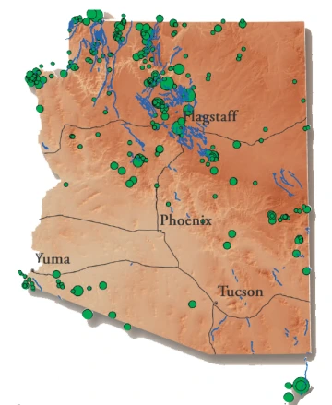
Why we care
Network performance check — are certain regions or depths harder to characterize?
Catalog QC — flag events whose recorded magnitude doesn't match what the detection parameters suggest
Real operational dataset I work with daily
Framework generalizes to other regional networks

Slide 4
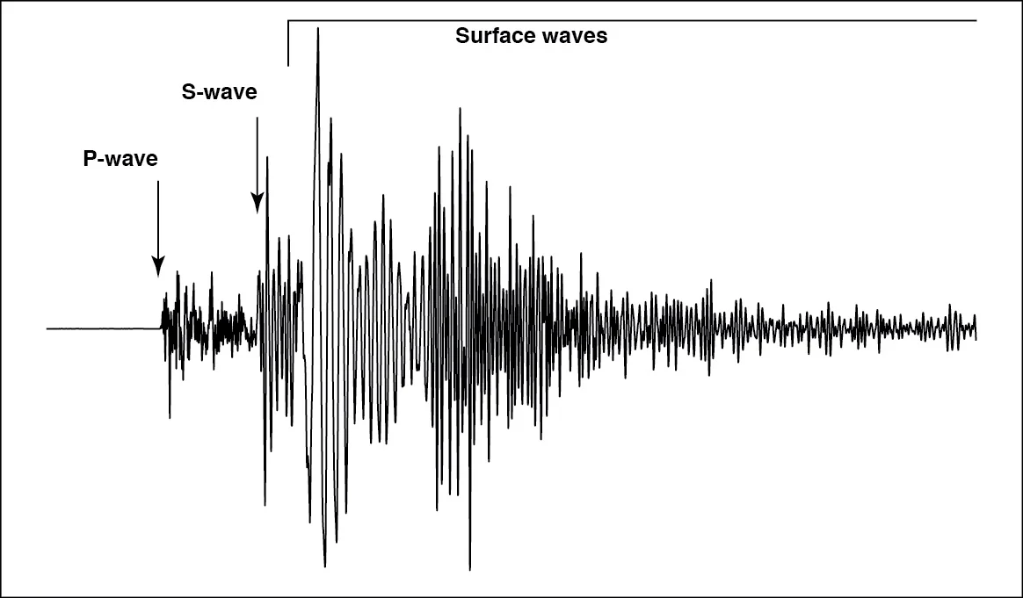
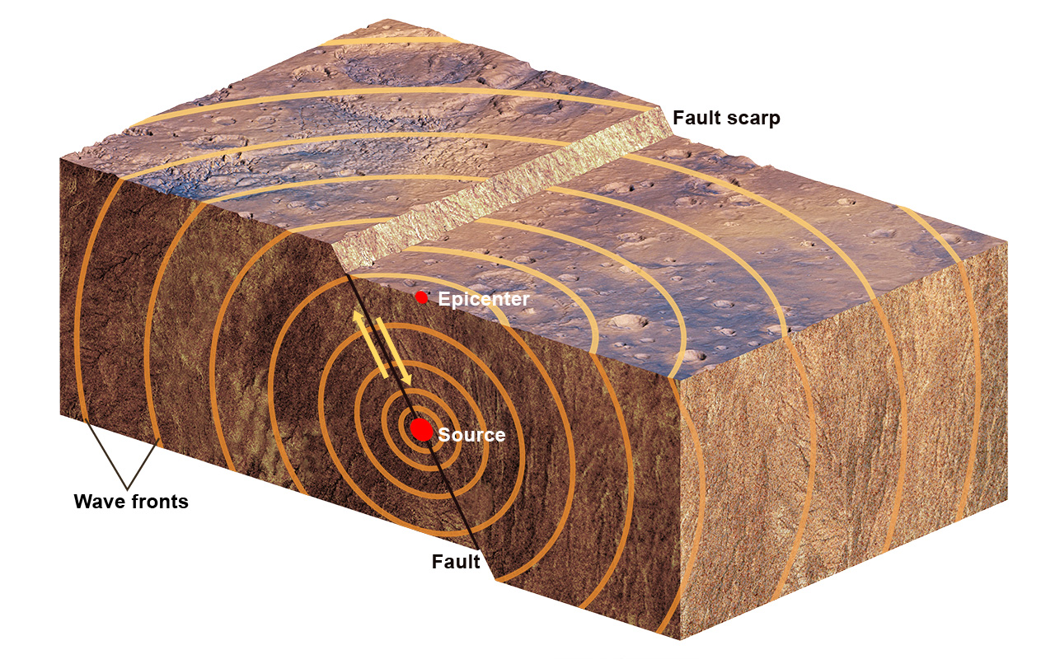
Earthquake 101
Earthquake = sudden energy release from slip on a fault
We deploy seismometers at known locations across Arizona
They record ground motion → we pick "phases" (P-wave arrives first, S-wave second)
Arrival times at multiple stations triangulate location + depth
Magnitude is computed separately from wave amplitude — log scale (M3 ≈ 32× the energy of M2)

Slide 5
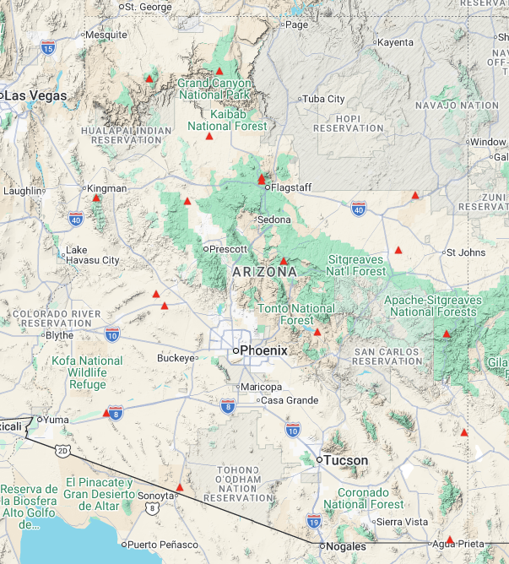
The Dataset
Source: AZGS earthquake catalog
Time range: May 2019 – November 2025
Raw: 4,756 events
After filtering for complete entries: 782 events
Target: Magnitude (continuous, range 0.4 – 4.5)
8 predictors (7 quantitative + 1 categorical)

Slide 6
The Variables
Variable | What it actually is
Depth | How far below the surface the quake originated (km).
Number of Phases | How many P/S arrivals were picked across all stations
Rms | Root Mean Square time residuals. How well the location fit the observations (sec). Lower = better fit.
Erh | Horizontal location uncertainty (km)
Erz | Vertical / depth uncertainty (km)
x, y | Longitude, Latitude
Type | ML (Richter-like) vs MD (duration-based) magnitude scale

Slide 7
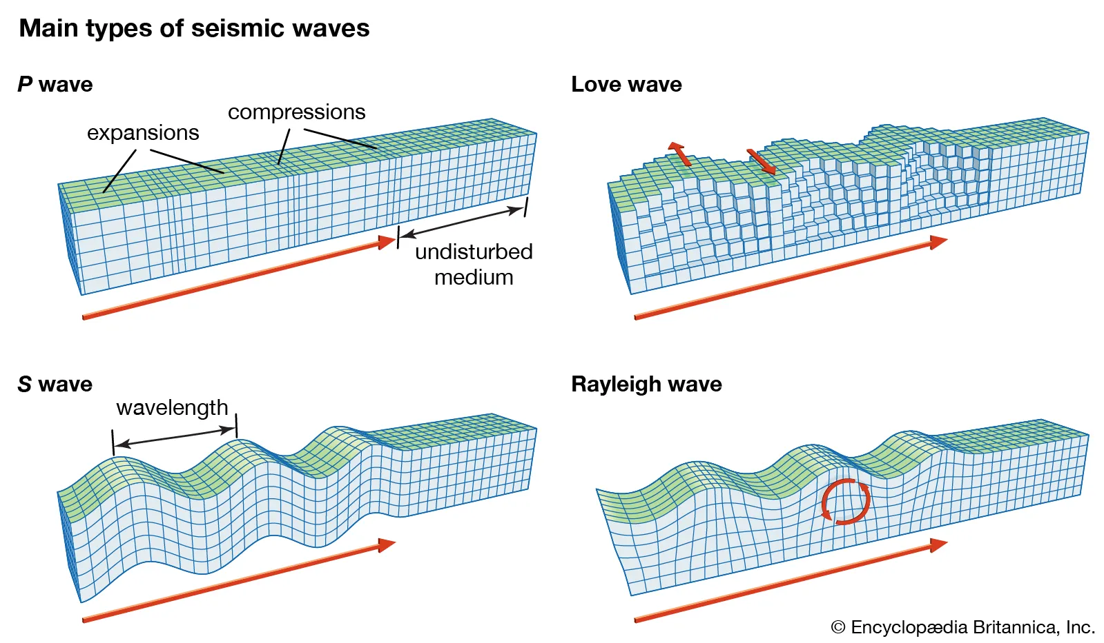
Cleaning the data
Dropped admin columns (IDs, timestamps, notes)
Dropped rows with missing or zero values in key fields
Removed obvious data entry errors (lat/lon outside Arizona, Rms = 101 sec)
Dropped the 3 Mw events (too few for the model)
Encoded Type as binary (1 = ML, 0 = MD)
4,756 → 782 events

Slide 8
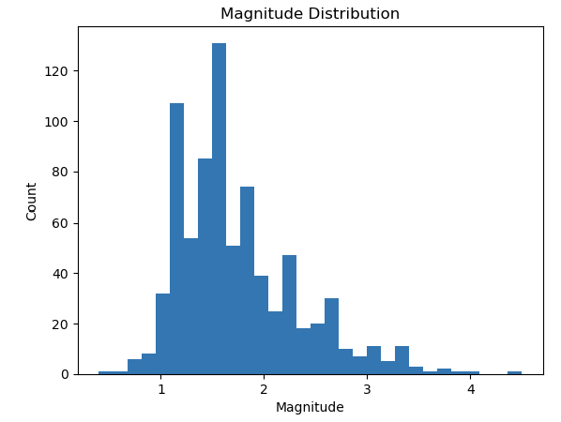
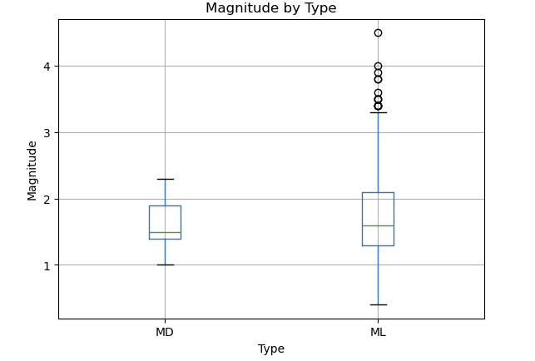
What the Data Looks Like
Heavily right-skewed (mean 1.74, median 1.6)
Mostly tiny events (M < 2.5)
Max in dataset: 4.5
ML dominates (732 vs 50 MD)

Slide 9
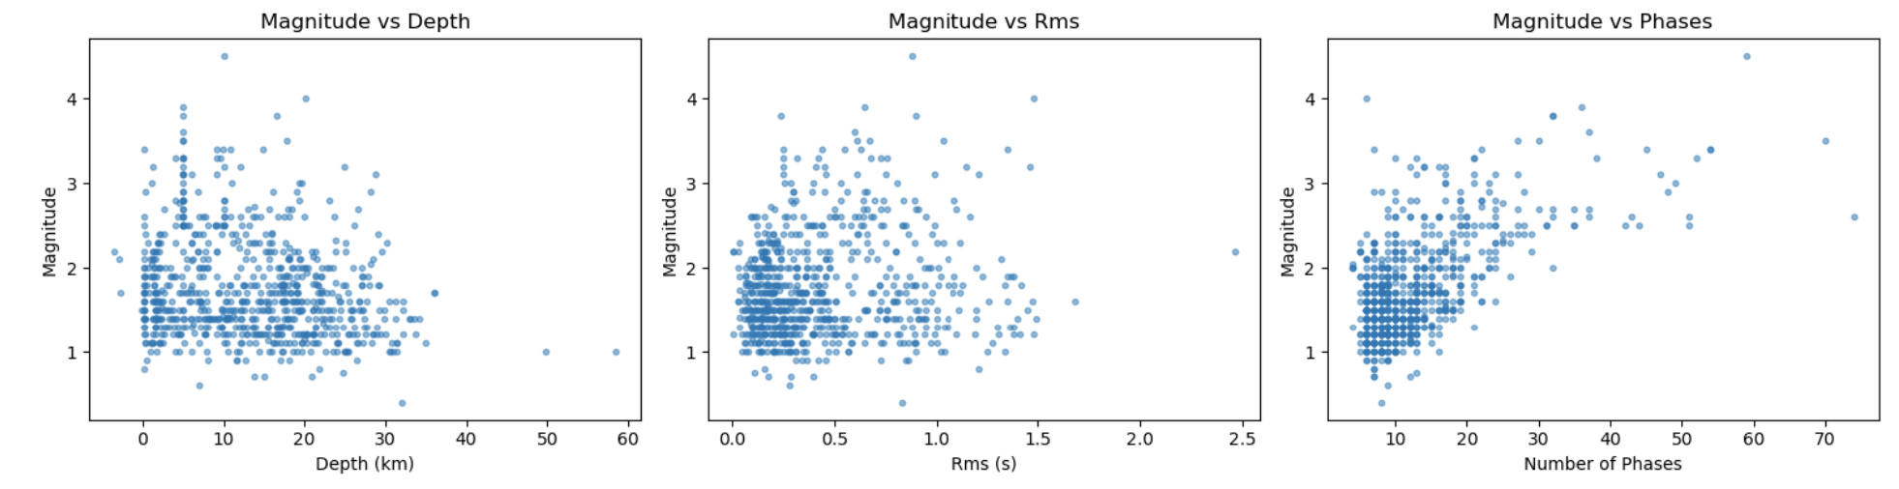
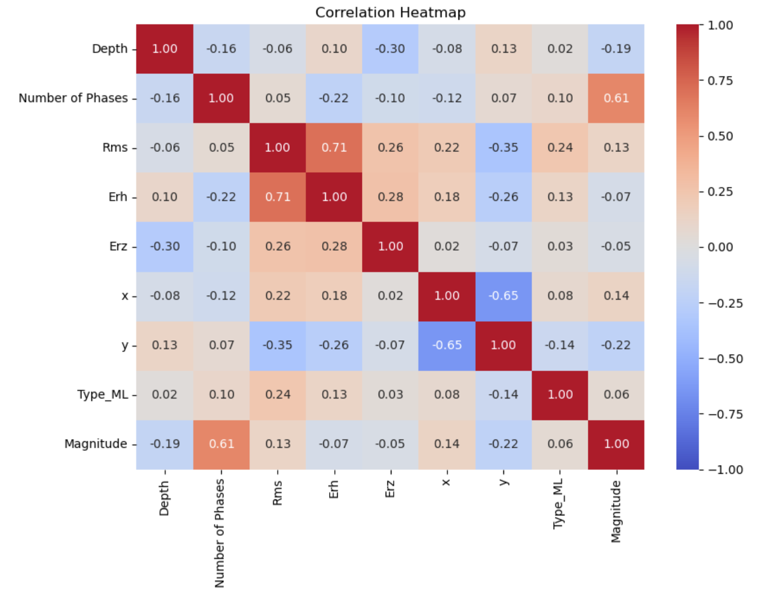
Variable relationships: Key Findings
Number of Phases ↔ Magnitude: r = 0.61 (strongest)
Latitude (y) ↔ Magnitude: r = -0.22
Depth ↔ Magnitude: r = -0.19
Rms ↔ Erh: r = 0.71 ← multicollinearity

Slide 10
Model Choice & Justification
Ridge Regression (linear)
Decision Tree Regressor (non-linear)
Handles Rms–Erh collinearity via L2 penalty
Interpretable coefficients
Baseline for the linear relationship
Captures non-linear patterns (depth–magnitude isn't straight)
No feature scaling needed
Interpretable splits — useful for QC rules
Provides feature importances

Slide 11
What I expect
Plan
Expectations
80/20 train/test split; standardize features for Ridge
Tune Ridge α via cross-validation
Tune tree max depth and min samples/leaf
Evaluate: R², RMSE, MAE
Predicted-vs-actual and residual plots
Number of Phases will dominate importance in both
Tree edges out Ridge but risks overfitting on 782 samples
Modest overall R² — magnitude is computed from amplitude, which isn't in this feature se

Slide 12
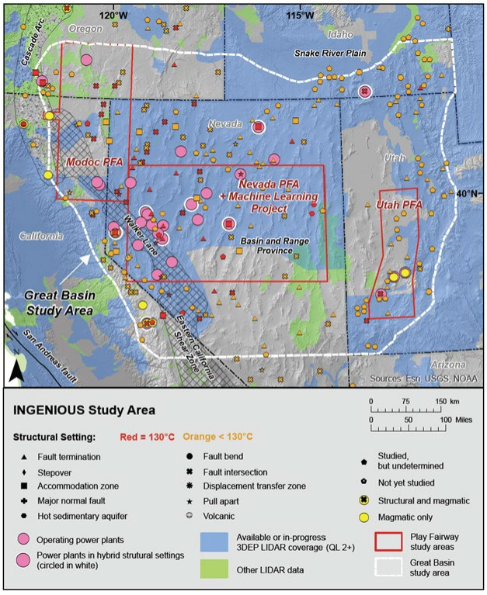
Workforce Takeaway
Connects directly to my AZGS network operations and QC work
Toolkit transfers to my longer-term projects
Same methods (regularized regression, tree models) underlie play fairway analysis and favorability mapping
Reinforces a core lesson: real data is messy; cleaning is the project

